Slide 1

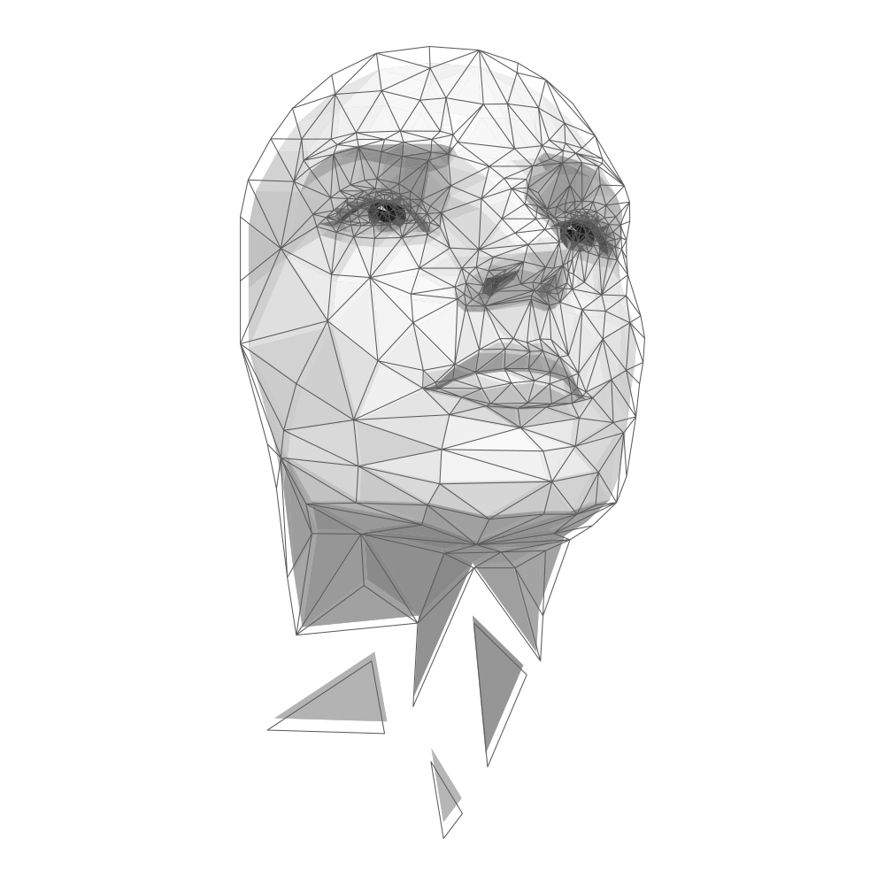
Face Sketch Creation and Recognition
GF’s
Godavari College of Engineering, Jalgaon
Branch:- Computer Engineering

Slide 2
Guided By:- Prof. Nilesh Wani (HOD, Computer Engineering)
Presented By
Tejal Zope
Harshal Koli
Devyani Gotiwale
Akshay Jagtap
Branch:- Computer Engineering

Slide 3
TABLE OF CONTENTS
Sr. No. | Contents
1) | PROBLEM STATEMENT
2) | OVERVIEW
3) | INTRODUCTION
4) | LITERATURE REVIEW
5) | TECHNOLOGY STACK
6) | SYSTEM FLOW & WORK FLOW
7) | RESULT & OUTPUT
8) | CONCLUSION
9) | FUTURE SCOPE
10) | REFERENCES

Slide 4
01
PROBLEM STATEMENT

Slide 5
PROBLEM STATEMENT
Increasing crime rates necessitate faster and more efficient processes for law enforcement departments to bring criminals to justice.
Face recognition technology can be a valuable tool for identifying and verifying offenders.
The traditional method of using hand-drawn face sketches by forensic artists has limitations and can be time-consuming.
However, this approach faces limitations with current technologies and a there are few skilled forensic sketch artists.
There is a need for an application that provides a comprehensive set of facial features for creating face sketches. This application would expedite the identification of criminals in a faster and more efficient manner.

Slide 6
02
OVERVIEW

Slide 7
OVERVIEW
Standalone application for constructing accurate composite face sketches.
Provides predefined facial feature sets as tools for resizing and repositioning.
Allows users to create composite face sketches based on eyewitness descriptions.
Supports hand-drawn sketches, making it compatible with traditional approaches.
Utilizes deep learning and cloud infrastructure to match sketches with law enforcement databases.
Enables identification and verification of criminals.

Slide 8
03
INTRODUCTION

Slide 9
INTRODUCTION
Hand-drawn face sketches are not effective or time-saving for matching and identifying criminals.
Previous techniques for converting hand-drawn sketches into digital format had limitations.
Existing composite face sketch applications had limited features and a cartoonist feel.
We aim to create an application that allows users to select individual features or upload hand-drawn features.
Our application aims to closely resemble hand-drawn sketches for easier adoption by law enforcement. Law enforcement can upload previous hand-drawn sketches to use the application for identification.
The application utilizes deep learning and cloud infrastructure for efficient matching and recognition. Machine learning algorithm suggests relevant facial features to decrease time and increase efficiency.

Slide 10
04
LITERATURE REVIEW

Slide 11
LITERATURE REVIEW
Study | Findings | Limitations
Kemp et al. (2016) | Accuracy of forensic sketches depends on the quality and detail of the witness's description. More detailed descriptions from witnesses lead to more accurate sketches. Interactive sketch systems allowing changes and adjustments by witnesses improve accuracy. | The proposed algorithm compared front-facing face sketches with human face photographs, making it easier to map them. Algorithms were less effective in mapping and matching face sketches from the database for not front-facing faces.
Kovera et al. (2019) | Forensic sketches are more accurate than composite sketches. Sequential lineup, where suspects are viewed one at a time, improves identification accuracy.
Bruce et al. (2019) | Witness accuracy in identifying suspects is higher for individuals of their own race. Accuracy is reduced when the sketch artist is of a different race. Matching the race of the sketch artist to the witness may improve identification accuracy.

Slide 12
LITERATURE REVIEW
Study | Findings | Limitations
Xiaoou Tang and Xiaogang Wang | Proposed a recognition method for synthesizing photo-sketches using a Multistage Markov Random Field Model. The model trained to decrease the difference between photos and sketches. Model divided the face sketch into patches for synthesis and recognition. | Overall results were not as expected
Zhang et al. (2019) | Presented an automatic and effective photo-to-sketch synthesizing method based on Dual transfer. Method involved inter-domain and intra-domain transfer. | Method implementation is challenging and has a high computational cost.
P. C. Yuen and C. H. Man | Proposed a method for searching human faces using sketches. Accuracy of about 70% achieved in experimental results. | Proposed method lacked the required accuracy for law enforcement needs.

Slide 13
05
TECHNOLOGY STACK

Slide 14



TECHNOLOGY STACK
JAVAFX
AWS
DEEP LEARNING
JavaFX is a powerful framework for building user interfaces (UI) in Java applications.
It provides a rich set of UI controls, layouts, and styling options to create visually appealing and interactive applications.
JavaFX supports multimedia, animation, and 3D graphics, allowing developers to create engaging user experiences.
AWS is a cloud computing platform provided by Amazon that offers a wide range of services, including computing power, storage, and databases, to help businesses scale and grow.
AWS S3 is a highly scalable and durable object storage service provided by Amazon.
AWS Recognition is a service that provides AI-powered image and video analysis capabilities.
Deep Learning is a subset of machine learning that focuses on artificial neural networks with multiple layers.
It is capable of automatically learning and extracting complex patterns and representations from large datasets.
Deep Learning has revolutionized various domains such as computer vision, natural language processing, face recognition and speech recognition.

Slide 15
06
SYSTEM FLOW

Slide 16
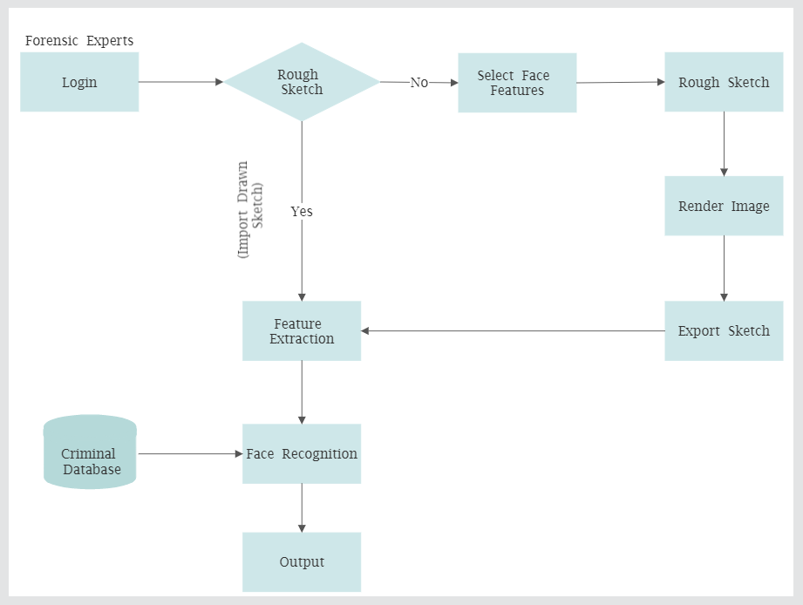
SYSTEM FLOW
System Flow Chart of the Application

Slide 17
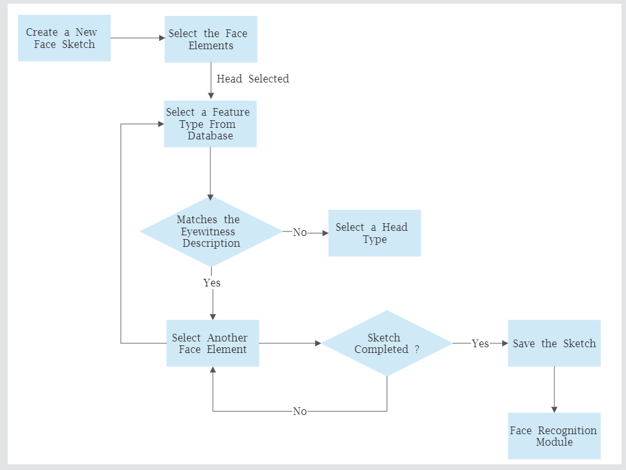
SYSTEM FLOW
Flow Chart for Creating a Sketch in the Application

Slide 18
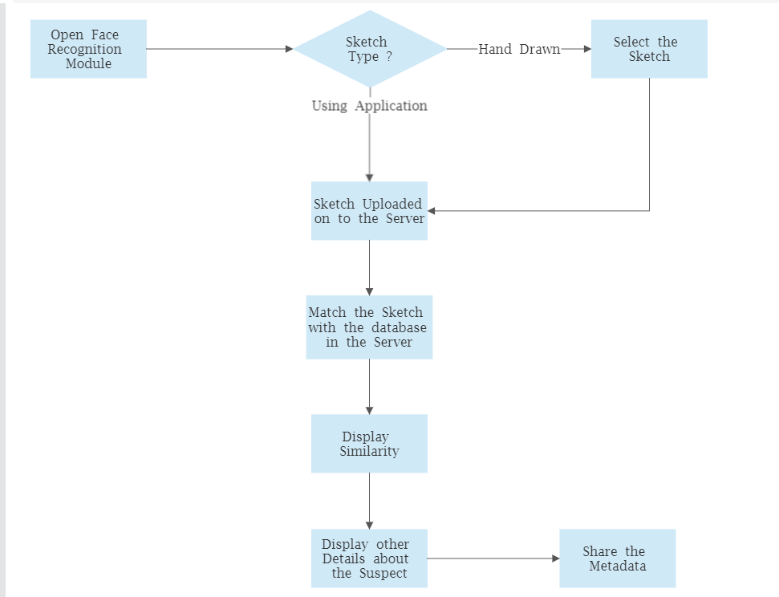
SYSTEM FLOW
Flow Chart for Recognizing a Sketch in the Application

Slide 19
06
WORK FLOW

Slide 20
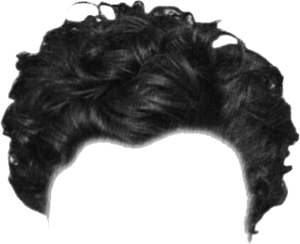
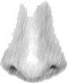
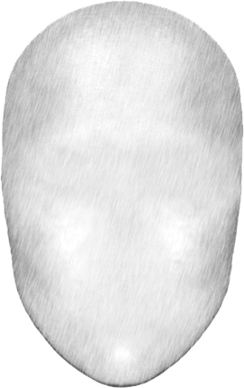
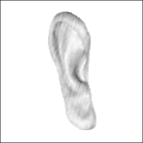
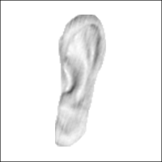


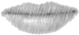
FACE FEATURES
There are some features which are used to recognise the face sketches/images. Ex. Head, Ear, Nose, Hair, Eyes, Lips.

Slide 21
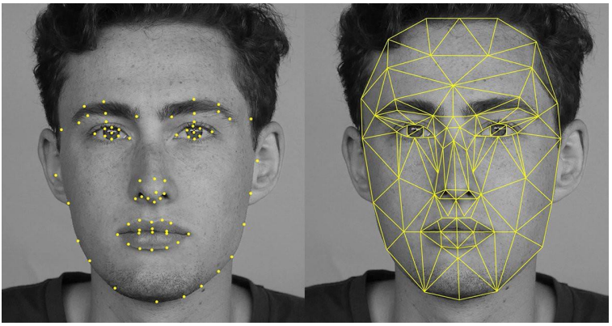
FACE MAPPING
Feature Extraction from the Face On the Platform

Slide 22
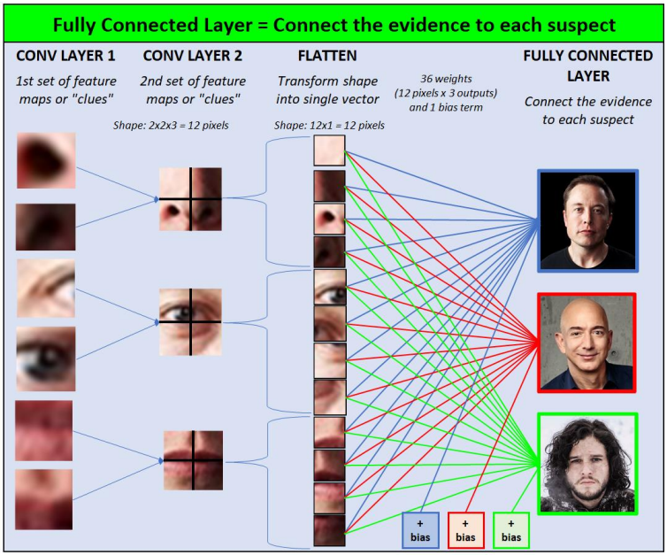
FACE MAPPING
Feature Extraction of Face

Slide 23
07
RESULT & OUTPUT

Slide 24
RESULT & OUTPUT

Slide 25
08
CONCLUSION

Slide 26
CONCLUSION
The project 'Face Sketch Construction and Recognition prioritizes security, privacy, and accuracy.
The platform implements security measures by matching MAC Address and IP Address with user credentials.
The OTP system restricts the use of previously generated OTPs and generates new OTPs upon reloading or re-login.
The face sketch construction and recognition process exhibited high accuracy (over 90%) and a confidence level of 100% in various test scenarios.
The platform offers unique features that differentiate it from related studies, enhancing overall security and accuracy.
The project stands out among proposed systems in the field of forensic face sketch construction and recognition.

Slide 27
09
FUTURE SCOPE

Slide 28
FUTURE SCOPE
The platform can be modified to match the Face sketch with the human faces from the video feeds by using the 3D mapping and imaging techniques and same can be implemented to the CCTV surveillances to perform face recognition on the Live CCTV footage using the Face Sketch.
Additionally, there is potential for the use of 3D printing technology to create physical models of suspects' faces, which can aid in identification. Overall, the use of technology in forensic investigations has the potential to greatly improve the efficiency and accuracy of criminal investigations.

Slide 29
10
REFERENCES

Slide 30
REFERENCES
B. Klare and A. Jain, “Sketch to photo matching: a feature-based approach”, SPIE Conference on Biometric Technology for Human Identification, 2010.
Kovera MB, Penrod SD, Pappas C, Thill DL (1997) Identification of computer-generatedfacial composites. Journal of Applied Psychology 82(2):235
Zhang Y, McCullough C, Sullins JR, Ross CR (2008) Human and computer evaluationsof face sketches with implications for forensic investigations. In: Biometrics: Theory, Applications and Systems, 2008.
Bruce V, Ness H, Hancock PJ, Newman C, Rarity J (2002) Four heads are better than one:combining face composites yields improvements in face likeness. Journal of Applied Psy-chology 87(5):894
Hamed Kiani Galoogahi and Terence Sim, “Face Sketch Recognition By Local Radon Binary Pattern: LRBP”, 19th IEEE International Conference on Image Processing, 2012.
N. Wang, X. Gao, and J. Li, “Random sampling for fast face sketch synthesis,” Pattern Recognit., vol. 76, pp. 215–227, 2018.

Slide 31
THANKS!

